Slide 1
Linux file system ,Basic and Advance commands
08/06/11

Slide 2
Understanding the Linux File System
The file system is organized in a hierarchical structure similar to an inverted tree
Linux file structure files are grouped according to purpose. Ex: commands, data files, documentation.

Slide 3
Understanding the Standard Tree Structure
The structure starts at the root level
  Root is the name of the file at this basic level and it is denoted by the slash character (/)
A directory is a file that can contain other files and directories
A subdirectory is a directory within a directory
  The subdirectory is considered the child of the parent directory

Slide 4
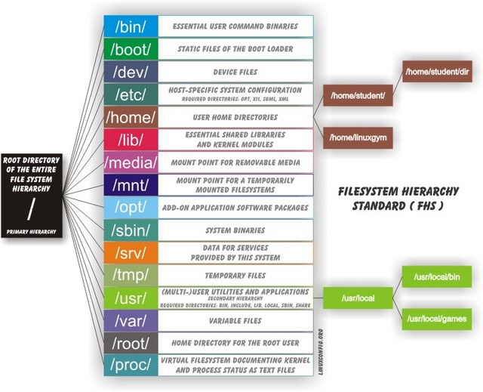
Vishal Kaushal

Slide 5
File System
1. / – Root
  Every single file and directory starts from the root directory.
  Only root user has write privilege under this directory.
  Please note that /root is root user’s home directory
2. /bin – User Binaries
  Contains binary executables.
  Common linux commands you need to use in single-user modes are located under this directory.
  Commands used by all the users of the system are located here.
  For example: ps, ls, ping, grep, cp.
3. /sbin – System Binaries
  Just like /bin, /sbin also contains binary executables.
  But, the linux commands located under this directory are used typically by system aministrator, for system maintenance purpose.
  For example: iptables, reboot, fdisk, ifconfig, swapon

Slide 6
4. /etc – Configuration Files
  Contains configuration files required by all programs.
  This also contains startup and shutdown shell scripts used to start/stop individual programs.
  For example: /etc/resolv.conf, /etc/logrotate.conf
5. /dev – Device Files
  Contains device files.
  These include terminal devices, usb, or any device attached to the system.
  For example: /dev/tty1, /dev/usbmon0
6. /proc – Process Information
  Contains information about system processes.
  It contains runtime system info like: system memory, devices mounted, hardware configuration, etc.

Slide 7
7. /var – Variable Files
  var stands for variable files.
  Content of the files that are expected to grow can be found under this directory.
  This includes — system log files (/var/log); packages and database files (/var/lib); emails (/var/mail); print queues (/var/spool); lock files (/var/lock); temp files needed across reboots (/var/tmp);
8. /tmp – Temporary Files
  Directory that contains temporary files created by system and users.
  Files under this directory are deleted when system is rebooted.
9. /usr – all programs are installed here.
- /usr/local -The place for locally installed software and other files.
10. /home – Home Directories
  Home directories for all users to store their personal files.
  For example: /home/john, /home/nikita

Slide 8
11. /boot – Boot Loader Files
  Contains boot loader related files.
  Kernel initrd, vmlinuz, grub files are located under /boot
  For example: initrd.img-2.6.32-24-generic, vmlinuz-2.6.32-24-generic
12. /lib – System Libraries
  Contains library files that supports the binaries located under /bin and /sbin
  Library filenames are either ld* or lib*.so.*
  For example: ld-2.11.1.so, libncurses.so.5.7
13. /opt – Optional add-on Applications
  opt stands for optional.
  Contains add-on applications from individual vendors.
  add-on applications should be installed under either /opt/ or /opt/ sub-directory.
  Google chrome need to be installed separately.

Slide 9
14. /mnt – Mount Directory
  Temporary mount directory where sysadmins can mount filesystems.
15. /media – Removable Media Devices
  Temporary mount directory for removable devices.
  For examples, /media/cdrom for CD-ROM; /media/floppy for floppy drives; /media/cdrecorder for CD writer
16. /srv – Service Data
  Srv is a serve folder.
  It holds site specific data to be served by the system for protocols such as, ftp, rsync, www, cvs etc.
08/06/11

Slide 10
Logging
You are now logged into the computer and will have a prompt that reflects the computer's name. sammy@webapp:~$
  sammy: The username of the current user
  webapp: The hostname of the server
  ~: The current directory. In bash, which is the default shell, the ~, or tilde, is a special character that expands to the path of the current user's home directory; in this case, it represents /home/sammy
  $: The prompt symbol. This denotes the end of the command prompt, after which the user's keyboard input will appear
At this point, you’re ready to enter your first linux command
exit—to sign off from the computer system. entering exit shuts down all programs

Slide 11
Every unix command is a sequence of letters, numbers and characters. But there are no spaces.
It is also case-sensitive. This means that cat and Cat are different commands.
The prompt is displayed by a special program called the shell.
Shells accept commands, and run those commands.
They can also be programmed in their own language. These programs are called “shell scripts”.

Slide 12
When you first login, the prompt is displayed by bash, and you are running your first unix program, the bash shell.
As long as you are logged in, the bash shell will constantly be running.

Slide 13

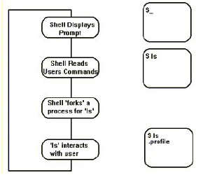

Slide 14
When the UNIX system starts up, it also starts a system process (getty) which monitors the state of each terminal input line. When getty detects a user has turned their terminal on, it presents the logon prompt and
once the password is validated, the UNIX system associates the shell program (/bin/sh) with that terminal.
Each user is presented with a shell. This is a program which displays the users prompt, handles user input and displays output on the terminal.
The shell program provides a mechanism for customising each users setup requirements, and storing this information for re-use (in the file .profile).
The user interacts with /bin/sh, which interprets each command typed. Internal commands are handled within the shell (set, unset), external commands are invoked as
programs (ls, grep, sort, ps)

Slide 15

Each command performs [variations of] a single task
  “options” can be used to modify what a command does
  different commands can be “glued together” to perform more complex tasks
Syntax:
    command options arguments
  Examples:
Options can (usually) be combined together:
these are equivalent
Command | Options | Arguments
pwd
cd |  | /home/debray
ls | -a -l
ls | -al | /usr/local

Slide 16
Each command performs [variations of] a single task
  “options” can be used to modify what a command does
  different commands can be “glued together” to perform more complex tasks
Syntax:
    command options arguments
  Examples:
Not always required: may have default values
typical defaults:
  input: stdin
  output: stdout
  directory: current
Command | Options | Arguments
pwd
cd |  | /home/debray
ls | -a -l
ls | -al | /usr/local
defaults to current directory

Slide 17
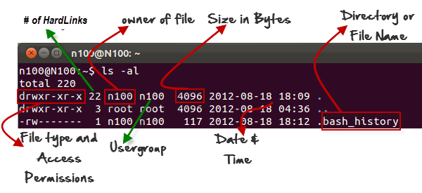
'ls -al' gives detailed information of the files.

Slide 18

TIPS
In case the backspace key does not work when you try to erase something at the Unix prompt, try pressing simultaneously Ctrl-h . It will erase one typed character every time you press it.
Do NOT put spaces, capital letters or unusual characters (as !) in file names.
For more information on a command type man command.

Slide 19
Help for commands
Figuring out which command to use
  apropos keyword
  man –k keyword
  “searches a set of database files containing short descriptions of system commands for keywords”

Slide 20

Figuring out how to use a command
  man command
  “displays the on-line manual pages”
Provides information about command options, arguments, return values, bugs, etc.

Slide 21

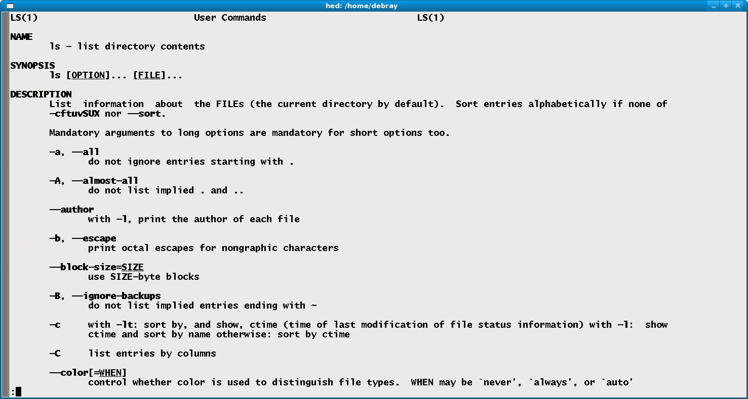
items within square brackets are optional
To exit
Press “q”

Slide 22

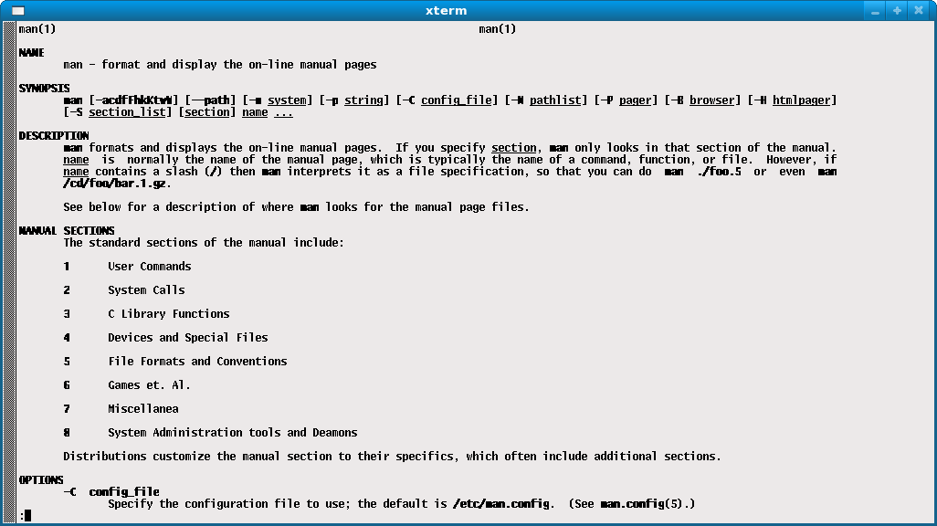

Slide 23
Logging In
To log in to a Unix machine you can either:
  sit at the console (the computer itself)
  access remotely, via SSH, e.g.
The system prompts you for your username and password.
Usernames and passwords are case sensitive!

Slide 24
Password
a password is a secret string that only the user knows (not even the system knows!)
When you enter your password the system encrypts it and compares to a stored string.
passwords should have at least 6 characters
It's a good idea to mix case, include numbers and/or special characters (don't use anything that appears in a dictionary!)

Slide 25
Home Directory
The user’s personal directory. E.g.,
  /home/student
  /home/vit
Your current directory when you log in
cd (by itself) takes you home
Location of many startup and customization files. E.g.:
  .vimrc .bashrc .bash_profile .forward .plan .mozilla/ .elm/ .logout

Slide 26
Files and File Names
A file is a basic unit of storage (usually storage on a disk).
Every file has a name.
Filenames are case-sensitive!
File names can contain any characters (although some make it difficult to access the file) except the null character and the slash (/).

Slide 27
Directories
A directory is a special kind of file - uses a directory to hold information about other files.
We often think of a directory as a container that holds other files (or directories).
A directory is the same idea as a folder on Windows.

Slide 28
More about File Names
Review: every file has a name (at least one).
Each file in the same directory must have a unique name.
Files that are in different directories can have the same name.

Slide 29
The Filesystem (eg)
/
bin
etc
home/
tmp
usr
VIT
student
bin
etc
OS
linux
X
ls
who

Slide 30
Pathnames
The pathname of a file includes the file name and the name of the directory that holds the file, and the name of the directory that holds the directory that holds the file, and the name of the … up to the root
The pathname of every file in a given filesystem is unique.
To create a pathname you start at the root (so you start with "/"), then follow the path down the hierarchy (including each directory name) and you end with the filename.
In between every directory name you put a "/".

Slide 31
Relative Pathnames
Prefixed w/the current directory, $PWD
So, relative to the current working directory
$ cd /home/VIT
$ pwd
/home/VIT
$ ls linux/Syllabus
linux/Syllabus
$ ls X
ls: X: No such file or directory
$ ls /home/student/X
/home/student/X

Slide 32
Special Relative paths…
. – The current directory
.. – The parent directory
$ pwd
/home/VIT
$ ls ./os
./os
$ ls ../student
X

Slide 33
Commands for Traversing Filesystem
ls – lists contents of a directory
  -a – all files
  -l – long listing
pwd – print working (current) directory
cd – change directory
  w/out argument, takes you home

Slide 34
Listing files (ls)
It shows the files /directories in your current directory.
OPTIONS:
  -l Lists all the files, directories and their mode, Number of links, owner of the file, file size, Modified date and time and filename.
  -t Lists in order of last modification time.
  -a Lists all entries including hidden files.
  -d Lists directory files instead of contents.
  -p Puts slash at the end of each directories.
  -u List in order of last access time.
  -i Display inode information.
  -ltr List files order by date.
  -lSr List files order by file size.

Slide 35
'ls -al' gives detailed information of the files.

Slide 36
Basic Commands (cont)
1.date: To display current date & time of the system.
2. cal :To display calendar of current month.
3. who:List who is currently logged on to the system.
4. Whoami:Report what user you are logged on as.
5. echo :Echo a string (or list of arguments) to the terminal
6. bc:To perform mathematical operations
7. clear:To clear the screen
8. alias : Used to tailor commands
Ex alias erase=rm Generate an employee report using AWK programming.
alias grep=”grep -i”
alias cp=“cp –i”
9. man <cmd name>: To get help for any command
10. passwd: To change the passward
11. exit: To logout from the terminal

Slide 37

passwd
With the passwd command, you can change the password associated with your individual account name.
For example,
sariyer:~> passwd
Changing password for dag.
Old password:
New passwd:
Retype new passwd:
sariyer:~>

Slide 38
Basic Commands (cont)
File & Directory Related Commands
1. cp <fromfile> <tofile>: Copy from the <fromfile> to the <tofile>
2. mv <fromfile> <tofile> : Move/rename the <fromfile> to the <tofile>
3. rm <file>:Remove the file named <file>
4. mkdir <newdir>:Make a new directory called <newdir>
5. rmdir <dir>:Remove an (empty) directory
6. cd <dir> :Change the current working directory to dir
7. pwd : Print (display) the working directory
8. cat > <file> :To create new file and save it by pressing ^d
9. cat >> <file>: To append contents into existing file
10. cat <file>:To see the contents of existing file
11. more <file>:Paging out the contents of file

Slide 39
Basic Commands (cont)
12. file <file>:To check the type of file
13. wc <file>:To count lines,words,charaters of file
14. cmp <file1> <file2>:To compare two files
15. comm <file1> <file2>:To display common values between two files
16. diff <file1> <file2>:To convert one file to another
17. gzip <file>:To compress the file
18. gunzip <file>:To unzip the contents of zipped file
19. ls :List the files in the current working directory
20. ls <dir>:List all files & directories in given directory
21. ln <fromfile><tofile>: Creates a symbolic link to a file

Slide 40
Advance commands
1. pr <file> :Paginating the file
Ex: pr –h “test” –d –n fname
2. head <file>:Display first 10 lines of file
Ex: head –n -3 fname
3. tail <file> :To display last 10 lines of file
Ex: tail -3 fname ; tail –c 100 fname
4. cut <file> :Splitting file vertically
Ex: cut –c 2-10,12-14 fname
cut –d “|” –f 2,4 fname
5. paste <file1> <file2> :To combine two file vertically rather than horizontally
Ex: paste –d “|” fname1 fname2
6. sort <file>:To sort file in order by field wise
Ex: sort –t”|” –k 2 fname
sort –r fname

Slide 41
Advance commands
7. uniq <file> :Locate repeated & nonrepeated lines
Ex: uniq fname; uniq –d fname
8. tr ch1 ch2 < <file1>:To translate occurrence of ch1 by ch2
Ex: tr ‘|’ ‘+’ < fname1
9. tee: read from standard input and write to standard output and files
Ex: ls *.txt | wc -l | tee count.txt

Slide 42
Some of the things these commands manipulate:
The time stamp: Each file has three dates associated with it. These are creation time, last modification time and last access time.
The owner: the owner of files
The group: the group of users
The permissions: read, write, execute permissions of files. The permissions tell unix who can access what file, or change it, or, in the case of programs, execute it. Each of these permissions can be toggled separately for the owner, the group, and all the other users.

Slide 43
File Time Attributes
Time Attributes:
  when the file was last changed ls -l
  sort by modification time ls -lt

Slide 44
Types of Users
user(owner): he is the user who create the file.
Group: They are the users who belong to the same group that the owner of the file belongs.
Others : they are any other users in the system.
And there is a super user (the root) is the administrator of the computer system which have access privileges to all files.
The login name for the super user is root and user id is 0.

Slide 45
Utilities for Manipulating file attributes
chmod change file permissions
chown change file owner
chgrp change file group
umask user file creation mode mask
only owner or super-user can change file attributes
upon creation, default permissions given to file modified by process umask value

Slide 46
File Owners
Each file is owned by a user.
You can find out the username of the file's owner with the -l or -o option to ls:
[jjohnson@ws44 winter]$ ls -l
total 24
drwxr-xr-x 7 jjohnson users 80 Jan 3 2005 cs265/
-rw------- 1 jjohnson users 8258 Jan 3 2005 cs265.html
-rw-r--r-- 1 jjohnson users 8261 Jan 3 2005 cs265.html~

Slide 47
Getting more information about files…
owner
group
size
last-modified time
file name
no. of hard links
access permissions
− | normal file
d | directory
l (ell) | symbolic link
file type

Slide 48
File access permissions
access permissions for others (o)
r | read
w | write
x | execute (executable file) enter (directory)
− | no permission
access permissions for group (g)
access permissions for owner (u)

Slide 49
File Permissions
Each file has a set of permissions that control who can mess with the file.
There are three types of permissions:
  read abbreviated r
  write abbreviated w
  execute abbreviated x
There are 3 sets of permission:
  user
  group
  other (the world, everybody else)

Slide 50
ls -l and permissions
-rwxrwxrwx
User Group Others
Type of file:
- – plain file
d – directory
b-block device file
c- character device file
l – symbolic link
p- pipe
s- socket

Slide 51
rwx
Files:
  r - allowed to read.
  w - allowed to write
  x - allowed to execute
Directories:
  r - allowed to see the names of the file.
  w - allowed to add and remove files.
  x - allowed to enter the directory

Slide 52
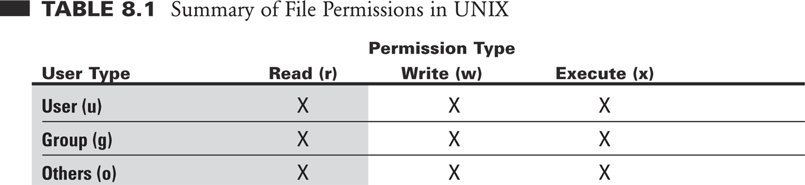
Access Types
The types of access permission are read, write and execute.

Slide 53
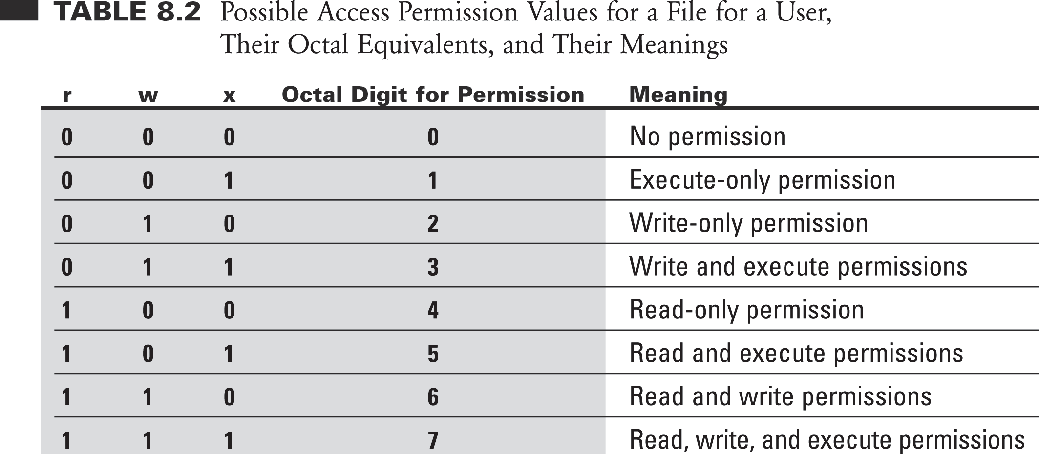
Access Types

Slide 54
Changing Permissions
The chmod command changes the permissions associated with a file or directory.
There are a number of forms of chmod, this is the simplest:
chmod mode file

Slide 55
chmod – numeric modes
Consider permission for each set of users (user, group, other) as a 3-bit #
  r – 4
  w – 2
  x – 1
A permission (mode) for all 3 classes is a 3-digit octal #
  755 – rwxr-xr-x
  644 – rw-r—r--
  700 – rwx------

Slide 56
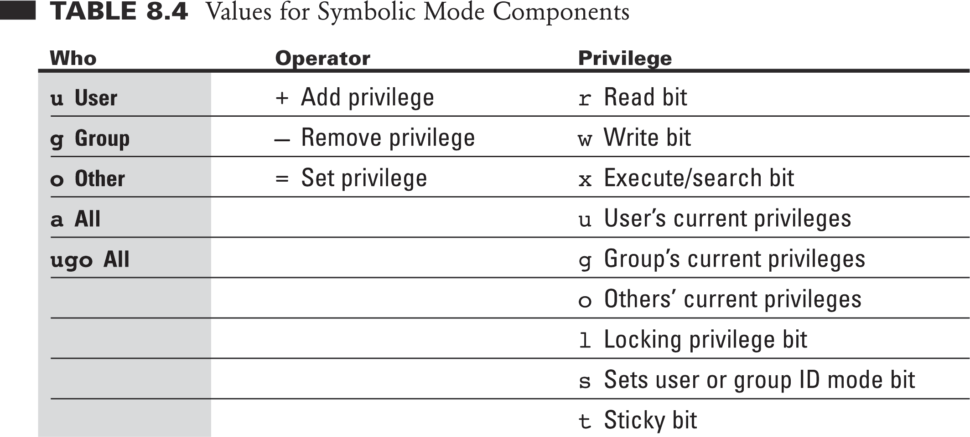
Changing file access privileges (cont…)

Slide 57
chmod - examples
$ chmod 700 CS571
$ ls –o Personal
drwx------ 10 kschmidt 4096 Dec 19 2004 CS571/
$ chmod 755 public_html
$ chmod 644 public_html/index.html
$ ls –ao public_html
drwxr-xr-x 16 kschmidt 4096 Jan 8 10:15 .
drwx--x--x 92 kschmidt 8192 Jan 8 13:36 ..
-rw-r--r-- 5 kschmidt 151 Nov 16 19:18 index.html
$ chmod 644 .plan
$ ls –o .plan
-rw-r--r-- 5 kschmidt 151 Nov 16 19:18 .plan

Slide 58
chmod – symbolic modes
Can be used to set, add, or remove permissions
Mode has the following form:
  [ugoa][+-=][rwx]
  u – user g – group o – other a – all
  + add permission - remove permission = set permission

Slide 59
chmod examples
$ ls -al foo
-rwxrwx--x 1 hollingd grads foo
$ chmod g-wx foo
$ ls -al foo
-rwxr----x 1 hollingd grads foo
$ chmod u-r .
$ ls
ls: .: Permission denied

Slide 60
Chown and chgrp: Changing File Ownership
There are two commands meant to manipulate the ownership of a file or directory – chown and chgrp.
They can be used only by the owner of the file. Here’s the syntax for both:
chown options new_user file(s)
chgrp options new_group file(s)

Slide 61
Chown and chgrp: Changing File Ownership
chown (change ownership) takes the new user’s user-id as argument followed by one or more files to change the file ownership.
The chgrp (change group) command changes the group owner of a file.
Both chown and chgrp also work with the –R option to perform their operations in a recursive manner.
The super user can change every file attribute.
# ls -lart tmpfile
-rw-r--r-- 1 himanshu family 0 2012-05-22 20:03 tmpfile
# chown root tmpfile
# ls -l tmpfile
-rw-r--r-- 1 root family 0 2012-05-22 20:03 tmpfile

Slide 62
Change the group
# ls -l tmpfile
-rw-r--r-- 1 himanshu family 0 2012-05-22 20:03 tmpfile
# chown :friends tmpfile
# ls -l tmpfile
-rw-r--r-- 1 himanshu friends 0 2012-05-22 20:03 tmpfile
Change both owner and the group
# ls -l tmpfile
-rw-r--r-- 1 root family 0 2012-05-22 20:03 tmpfile
# chown himanshu:friends tmpfile
# ls -l tmpfile
-rw-r--r-- 1 himanshu friends 0 2012-05-22 20:03 tmpfile

Slide 63
Using chown command on symbolic link file
ls -l tmpfile_symlnk
lrwxrwxrwx 1 himanshu family 7 2012-05-22 20:03 tmpfile_symlnk -> tmpfile
# chown root:friends tmpfile_symlnk
# ls -l tmpfile_symlnk
lrwxrwxrwx 1 himanshu family 7 2012-05-22 20:03 tmpfile_symlnk -> tmpfile
# ls -l tmpfile
-rw-r--r-- 1 root friends 0 2012-05-22 20:03 tmpfile
When the chown command was issued on symbolic link to change the owner as well as the group then its the referent of the symbolic link ie ‘tmpfile’ whose owner and group got changed.
This is the default behavior of the chown command.
Also, there exists a flag ‘–dereference’ for the same.

Slide 64
Using chown command to forcefully change the owner/group of symbolic file.
Using flag ‘-h’, you can forcefully change the owner or group of a symbolic link as shown below.
# ls -l tmpfile_symlnk
lrwxrwxrwx 1 himanshu family 7 2012-05-22 20:03 tmpfile_symlnk -> tmpfile
# chown -h root:friends tmpfile_symlnk
# ls -l tmpfile_symlnk
lrwxrwxrwx 1 root friends 7 2012-05-22 20:03 tmpfile_symlnk -> tmpfile

Slide 65
umask: Default File Permissions
The default permissions are inherited by files and directories created by all users:
  rw-rw-rw- (octal 666) for regular files
  rwxrwxrwx (octal 777) for directories
However, these are not the permissions you see. This default is transformed by subtracting the user mask from it to remove one or more permissions.
This mask is evaluated by using umask:
$ umask
student@unix-13:~$ umask
0022
student@unix-13:~$

Slide 66
umask: Default File Permissions
$ umask
77
This is an octal number, and subtracting this value from the file default yields 666 – 077 = 600.
This represents the default permissions (rw-------) when you create a file.
The default directory permissions are set (rwx------) when a directory is created.

Slide 67
Filter and Redirection:

Slide 68
Pipes – connecting processes
A pipe is a holder for a stream of data.
A pipe can be used to hold the output of one program and feed it to the input of another.
prog1
prog2
STDOUT
STDIN

Slide 69
Asking for a pipe
Separate 2 commands with the “|” character.
The shell does all the work!
ls -1 | sort
ls -1 | sort > sortedlist
ls -1 | sort | head > top.ten

Slide 70
filters
Programs that read some input (but don’t change it), perform a simple transformation on it, and write some output (to stdout)
Some common filters…
  wc – word count (line count, character count)
  tr – translate
  grep, egrep – search files using regular expressions
  sort – sorts files by line (lexically or numerically)
  cut – select portions of a line
  uniq – Removes identical adjacent lines
  head, tail – displays first (last) n lines of a file

Slide 71
pipes and combining filters
Connect the output of one command to the input of another command to obtain a composition of filters
who | wc -l
ls | sort -f
ls -s | sort -n
ls -l | sort -nr -k4
ls -l | grep ‘^d’

Slide 72
pr
pr <file> :Paginating the file
  Ex pr –h “test” –d –n fname
admin36@soft36:~$ pr -n -h "trial" test
2014-01-29 17:07 trial Page 1
1 This is test file
2 hello vit

Slide 73
sort
sort <file>:To sort file in order by field wise
Ex sort –t”|” –k 2 fname
sort –r fname

Slide 74
cut
cut <file> :Splitting file vertically
Ex cut –c 2-10,12-14 fname
a. cut –d “|” –f 2,4 fname

Slide 75
paste
paste <file1> <file2> :To combine two file vertically rather than horizontally
Ex paste –d “|” fname1 fname2

Slide 76
head
head <file>:Display first 10 lines of file
Ex head –n -3 fname

Slide 77
tail
tail <file> :To display last 10 lines of file
Ex tail -3 fname ;
tail –c 100 fname

Slide 78
tee
tee: read from standard input and write to standard output and files
Ex. ls *.txt | wc -l | tee count.txt

Slide 79
uniq
uniq <file> :Locate repeated & nonrepeated lines
Ex uniq fname; uniq –d fname

Slide 80
tr
The “translate characters” command operates on standard input-it doesn’t accept a filename as a parameter.
Instead, it’s two parameters are arbitrary strings.
It replaces all occurences of string1 in the input string2.
In addition to relatively simple commands such as tr frog toad, tr can accept more complicated commands.
    tr string1 string2
admin40@admin40-OptiPlex-360:~$ cat >test
this is test file
admin40@admin40-OptiPlex-360:~$ tr '[a-z]' '[A-Z]' <test
THIS IS TEST FILE
admin40@admin40-OptiPlex-360:~$

Slide 81
Redirection
1. Standard input redirection: It is used to redirect standard input.
Ex. cat < fname
2. Standard output redirection : It is used to redirect standard output.
Ex cat >fname
3. Standard error redirection: It is used to redirect standard error.
Ex cat fname 2>Errorfile

Slide 82
Grep: Global Regular Expression Print
Searching and pattern matching tools
Searches files for one or more pattern arguments. It does plain string, basic regular expression, and extended regular expression searching
Following are some of the options for grep
-i ignore case for matching
-v doesn’t display lines matching expression
-n display line numbers along of occurrences
-c counting number of occurrences
-l display list of file names
-e exp for matching
-f file take patterns from file
-E treat pattern as an extended reg. exp
-F matches multiple fixed strings (fgrep)

Slide 83
Grep: Global Regular Expression Print
grep -ow "yourstring“
grep -w "search_word" text_file
grep -P '^(tomcat!?)' tst1.txt
08/06/11

Slide 84
Programming Tools and Utilities Available under Linux
Text Editors
  Xemacs
  Emacs
  Pico
  vi
Compilers
  C compiler - gcc
  C++ compiler - g++
  Java compiler & Java Virtual Machine - javac & java
Debuggers
  C / C++ debugger - gdb
Interpreters
  Perl - perl
  Tcl/Tk - tcl & wish
Miscellaneous
  Web Browsers - Mozilla, Netscape, Firefox, and Lynx (lynx is text based)
  Instant Messengers - Gaim
  Email - Netscape is there, but we will learn Pine

Slide 85
Try following commnads
compgen
fg
Bg
Zcat
du
df
touch
which
08/06/11

